Slide 1

PLEASE USE THIS TEMPLATE TO CREATE PRESENTATIONS USING THE WVU BRAND.

Slide 2
SPECS
PowerPoint includes: background images, and themes for 16x9 format
Recommended software: Microsoft Office PowerPoint 2007 or Microsoft Office PowerPoint for Mac 2008 and above
To ensure the presentation functions and displays properly, please be sure the software has the most current updates and service packs
Earlier versions of PowerPoint (’97-’03) use .ppt file format
* .pptx is convertible to .ppt via Microsoft Office Document Converter

Slide 3
BASIC OPTIONS
Dimension: 16x9
Slide Layout
Background Image
Text Color and Size
Adaptable Theme
College or Department Name

Slide 4

DIMENSION: 16x9
Wide screen
Standard
16x9
4x3
Choose the presentation size dependent on the intended output
* Most monitors, projectors, and computer screens are capable of displaying wide screen (16x9)
College or Department Name

Slide 5

SLIDE LAYOUT
Select a layout style dependent on page content

Slide 6

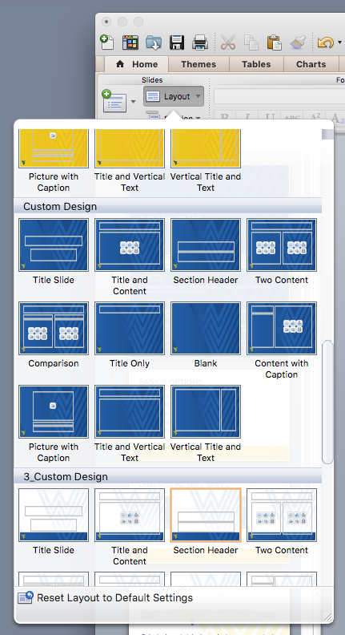
BACKGROUND IMAGE
Insert new slide
Click Layout
Scroll through sample background files
Select desired background and layout depending on content needed for slide

Slide 7
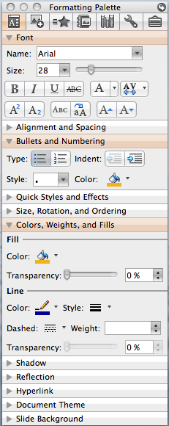
TEXT COLOR AND SIZE
Use the formatting palette to edit selected text’s color and size
You can use the recent color palette that includes WVU gold and blue

Slide 8
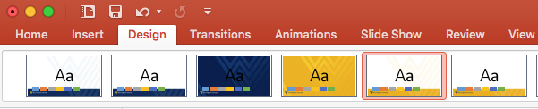
ADAPTABLE THEME
Under the Design tab you can apply a theme to previously created presentations
Create or save theme

Slide 9
FOR MORE INFORMATION ON THE WVU BRAND GO TO: BRAND.WVU.EDU

